Slide 1
RO plots to show lineage priming
William Li

Slide 2
Lineage Identity | Markers
Pluripotent | NANOG
 | OCT4
 | SOX2
Neuro-retinal stemness related | MECOM
 | RELN
 | COL9A1
 | PCDH7
 | ATOH7
Early retinal progenitor cells | PAX6
 | VSX2
 | SOX1
 | RAX
 | LHX2
 | SIX3
 | SIX6
Late retinal progenitor cells | ASCL1
 | HES6
Neurogenic | ATOH7
 | HES6
 | DLL3
Photoreceptor precursors | NRL
 | CRX
 | OTX2
 | OLIG2
Retinal Pigmented Epithelium | MITF
 | GJA1
 | PCDH7
 | RELN
Dorgau, et al., (2024). Nat. Commun.
Liu, et al., (2025). Science Translational Medicine

Slide 3
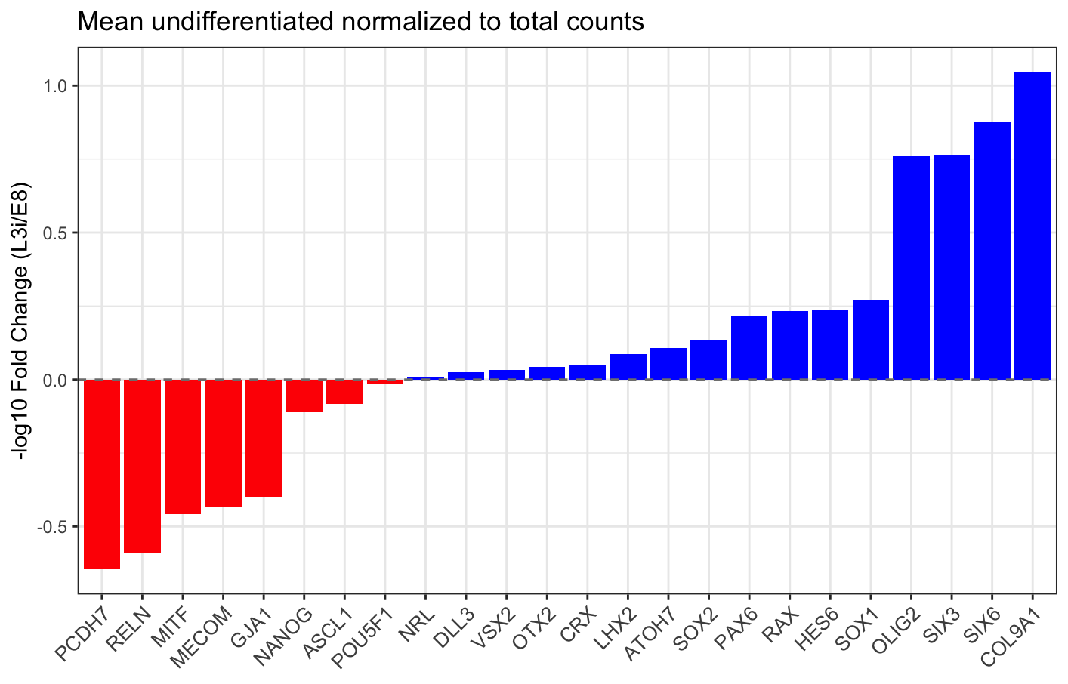
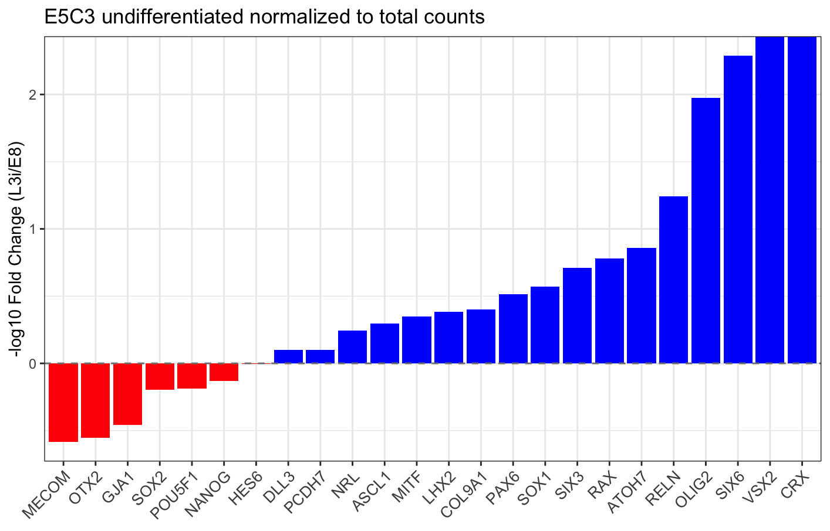
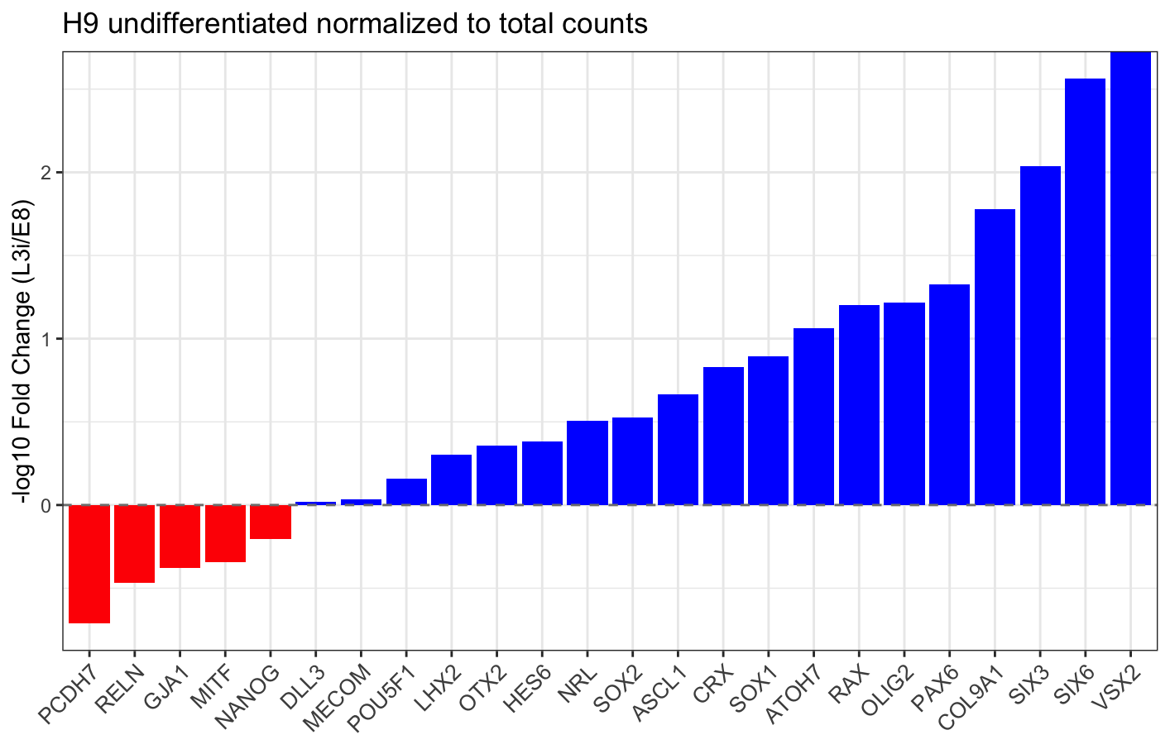
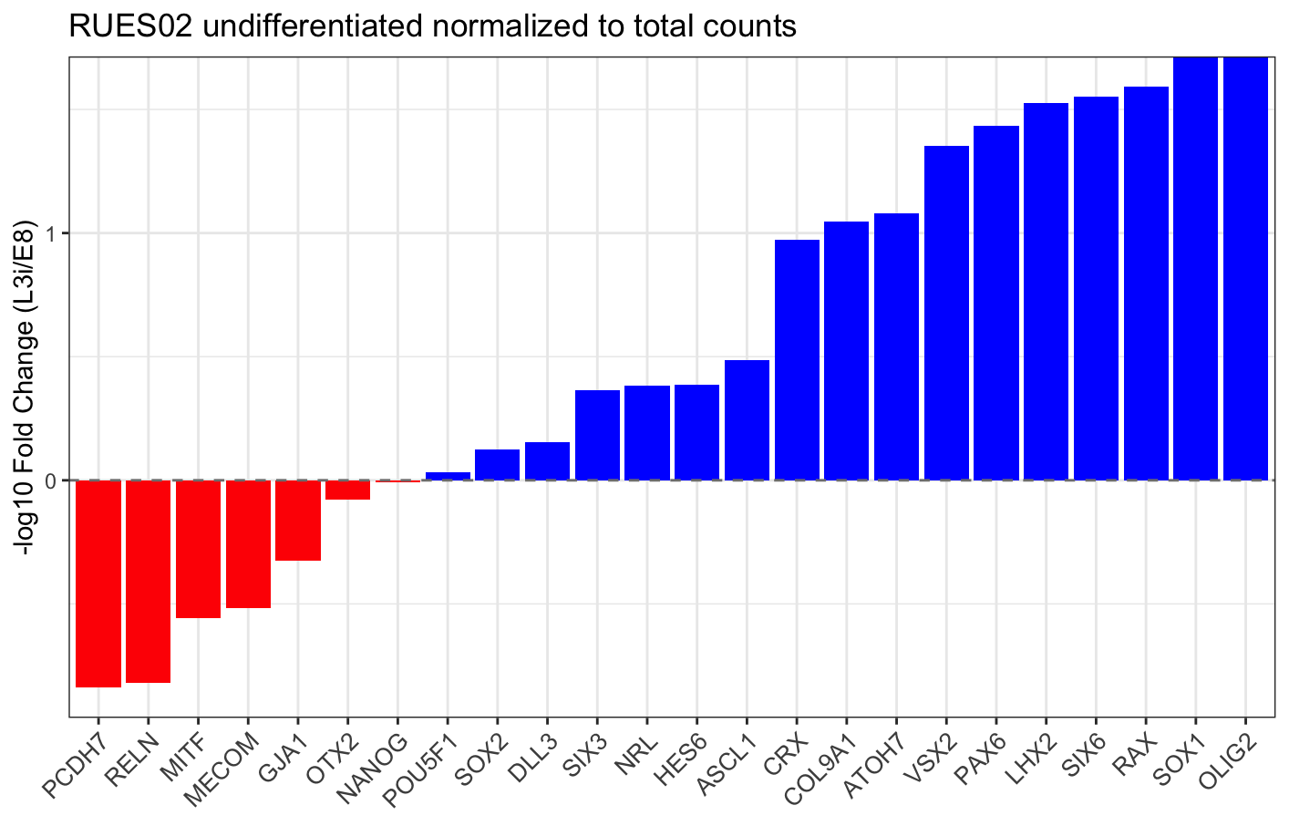

Slide 4
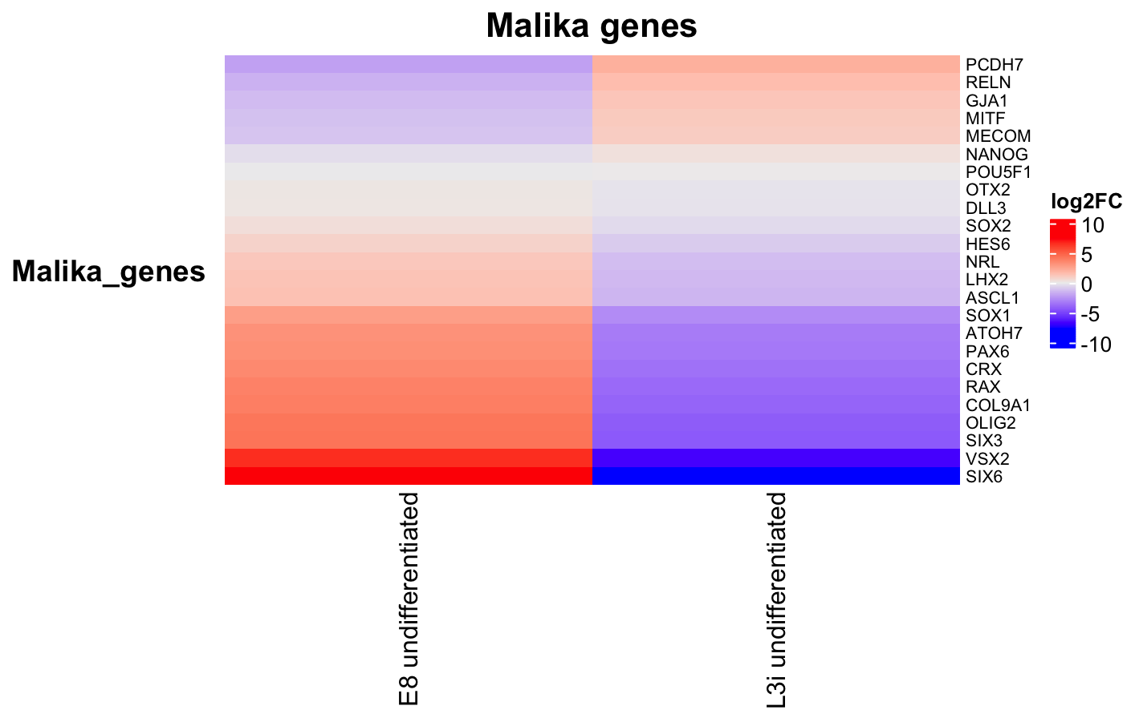
Averaged gene expression across all primed lineages

Slide 5
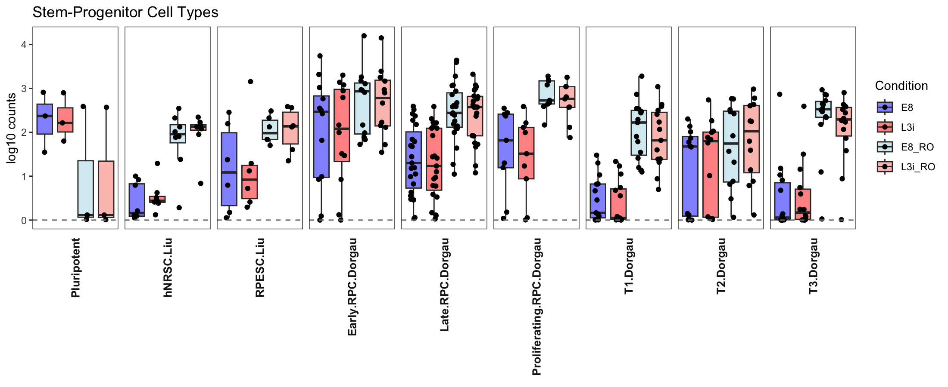
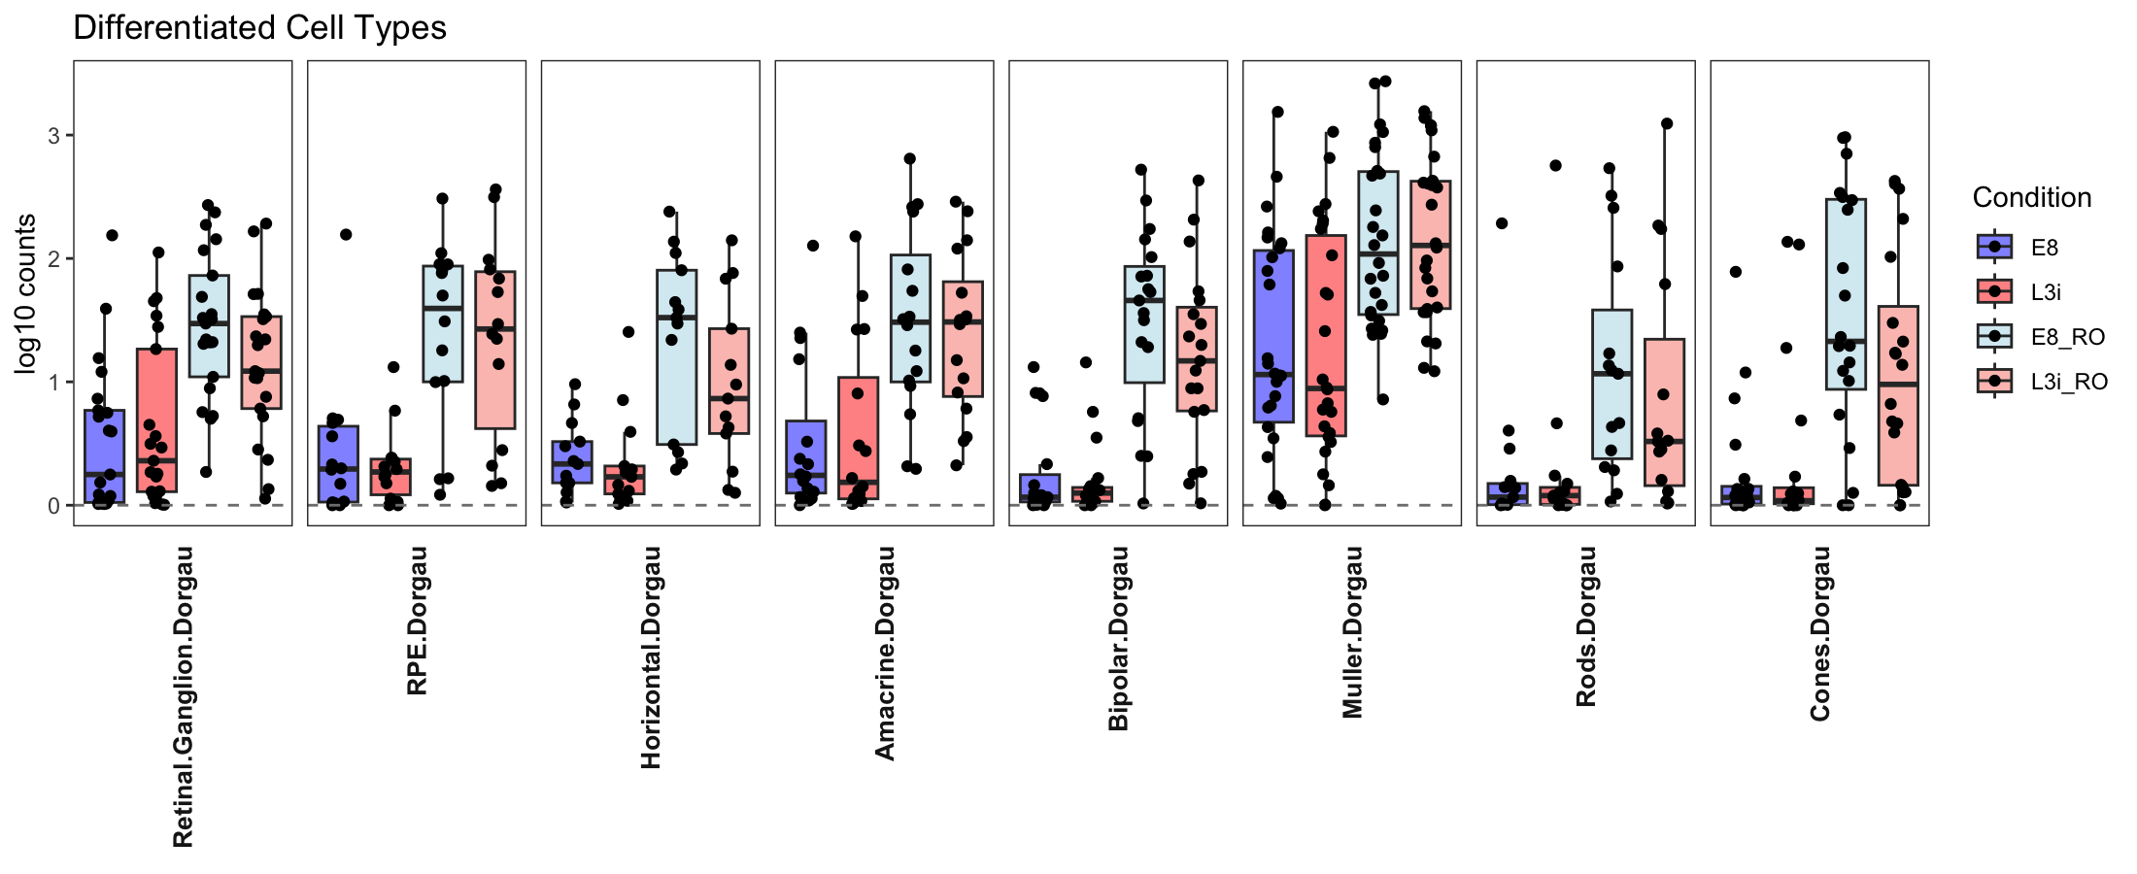
Stem-progenitor cell types
Log counts
Differentiated cell types
Log counts

Slide 6
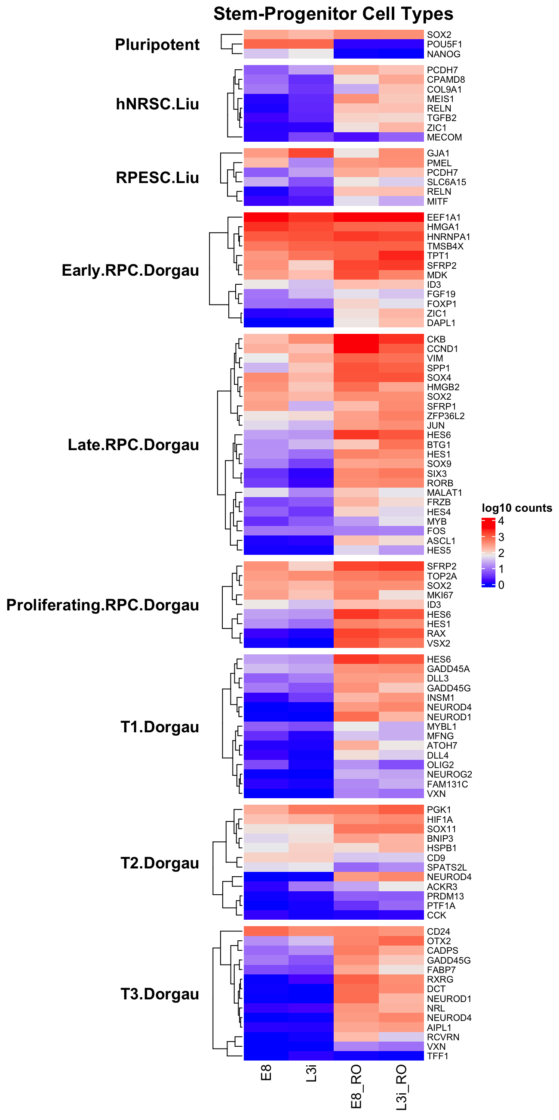
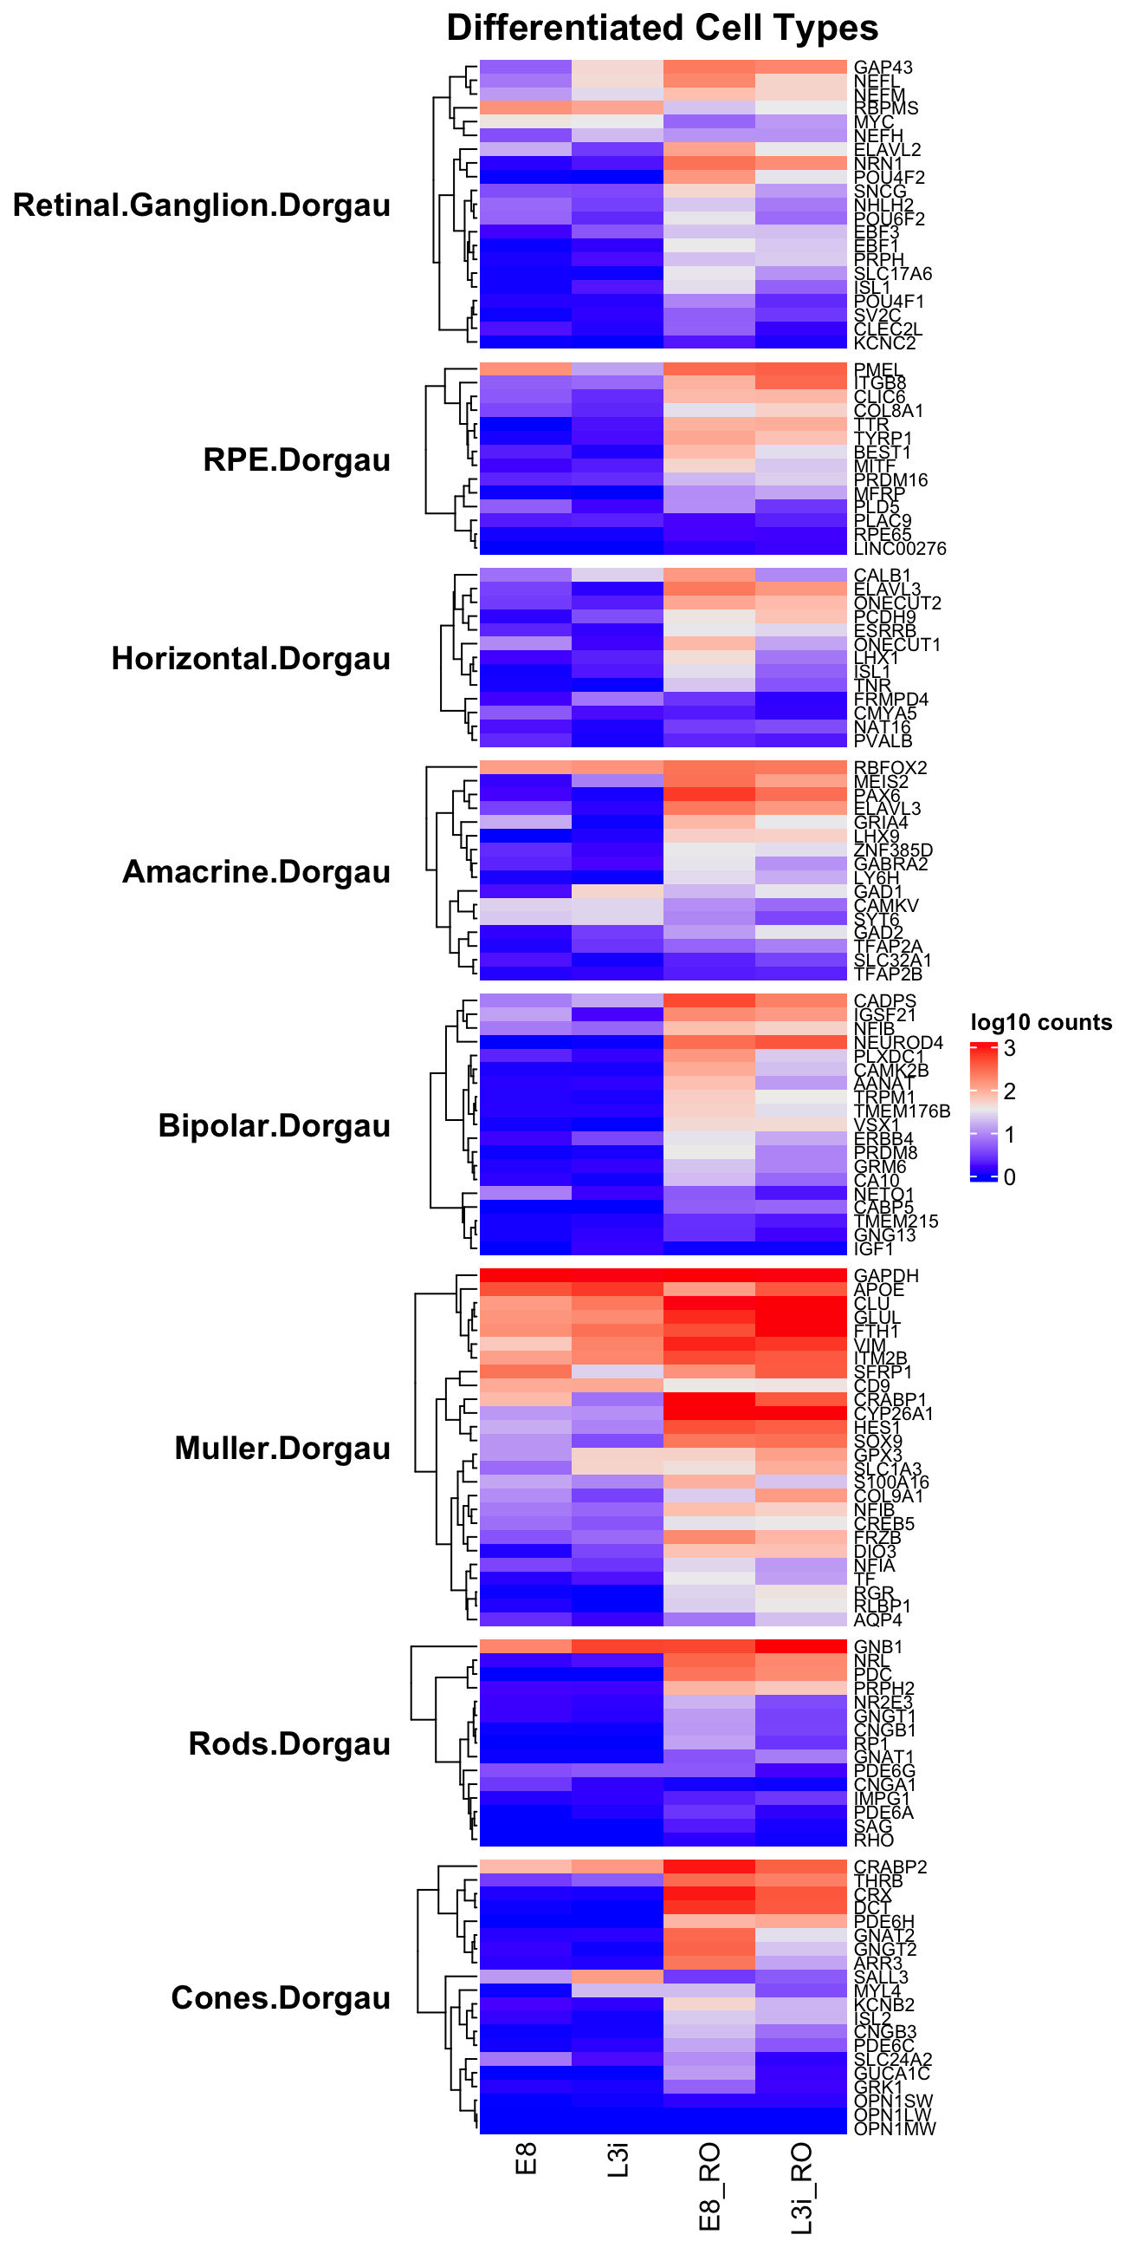
Stem-progenitor cell type genes
normalized
Log10 counts
Differentiated cell type genes
normalized
Log10 counts

Slide 7
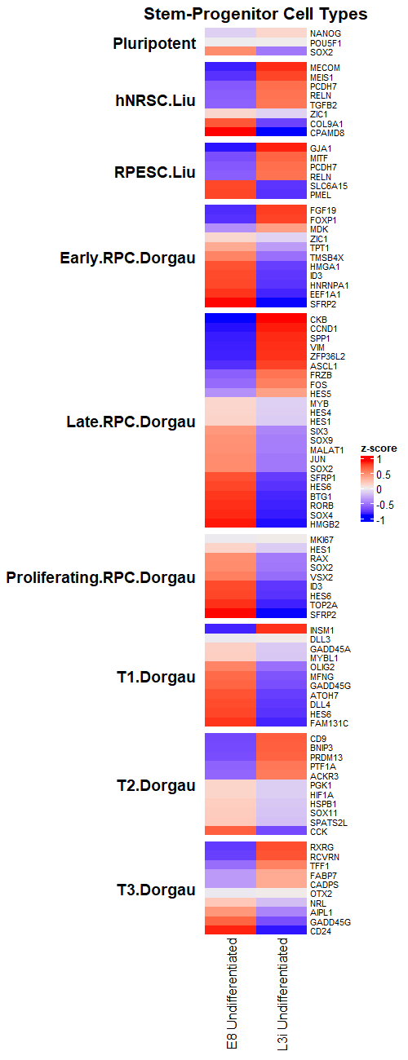
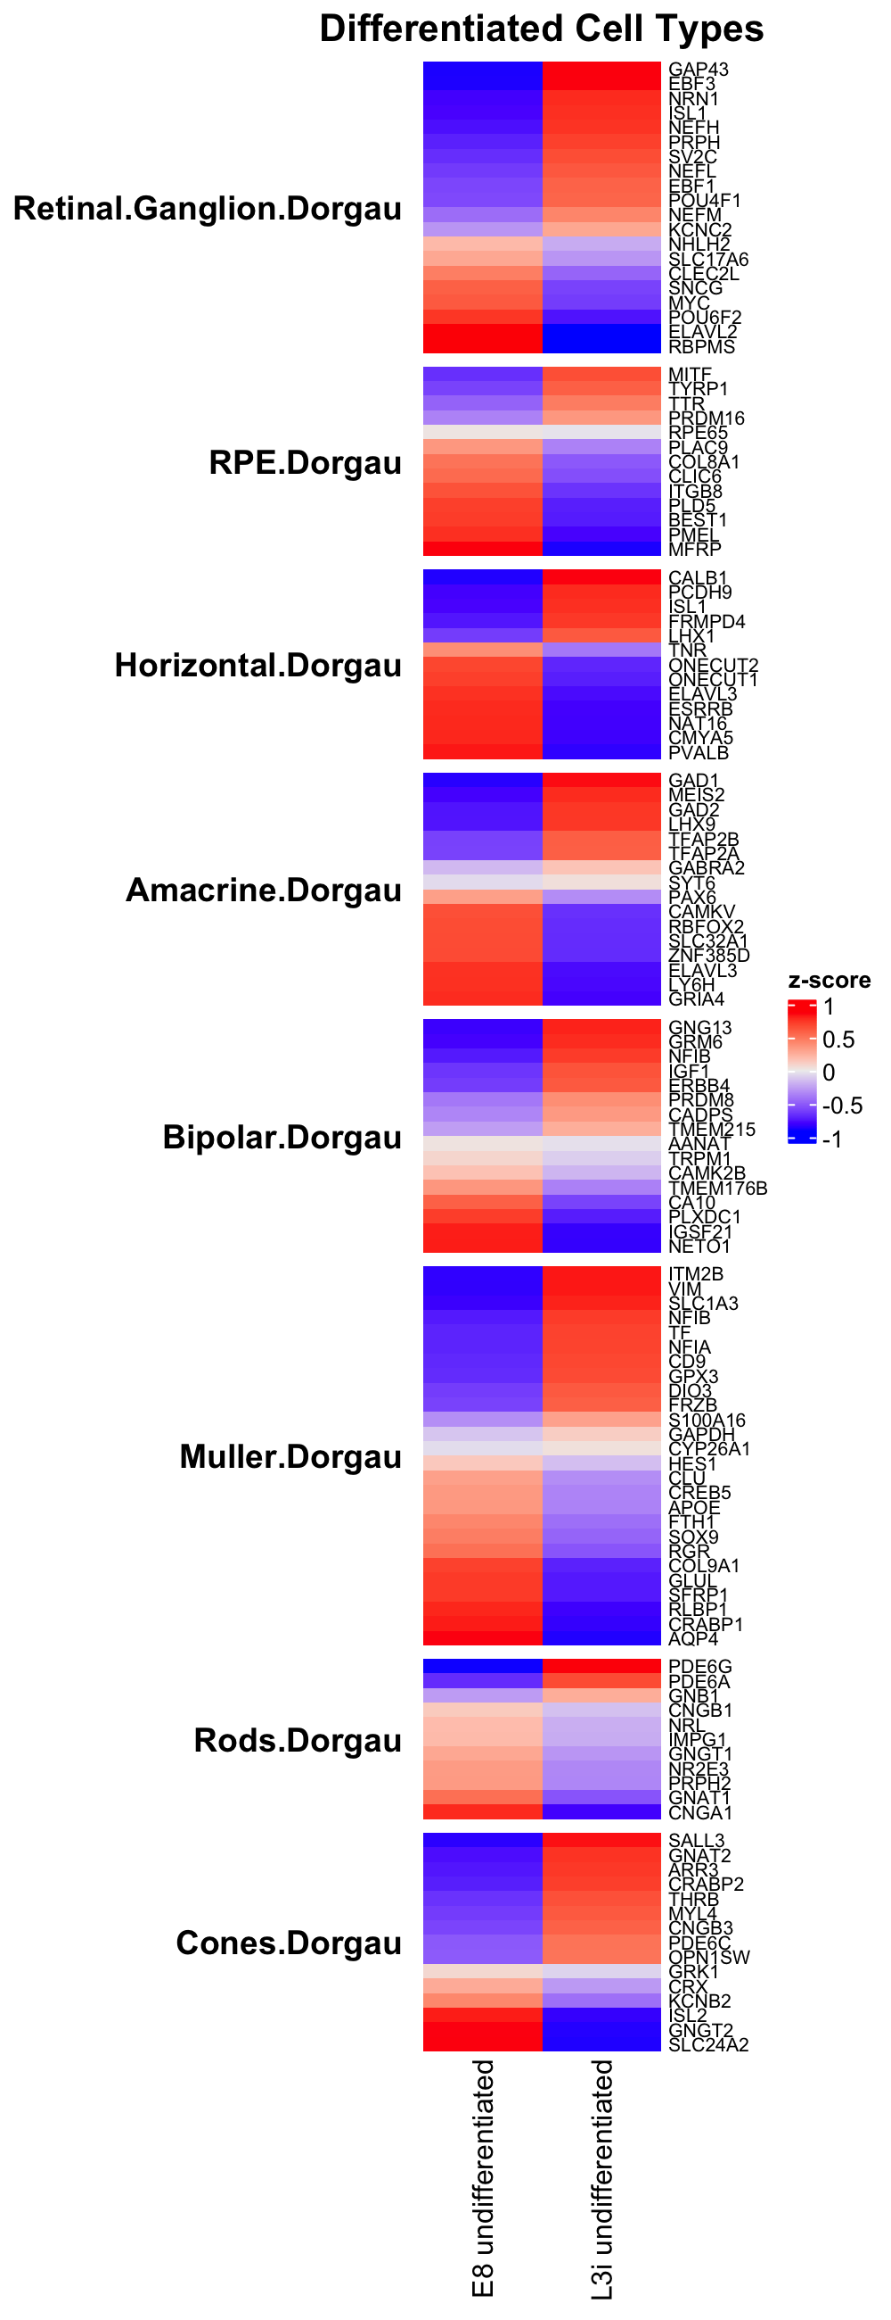
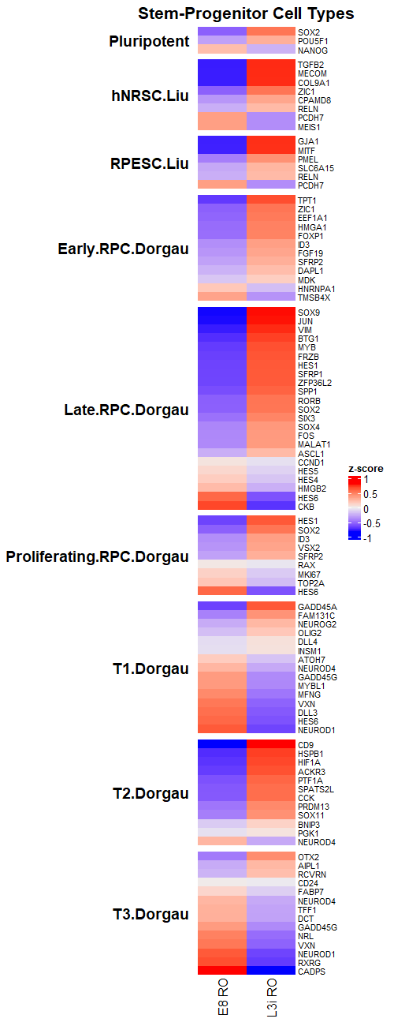
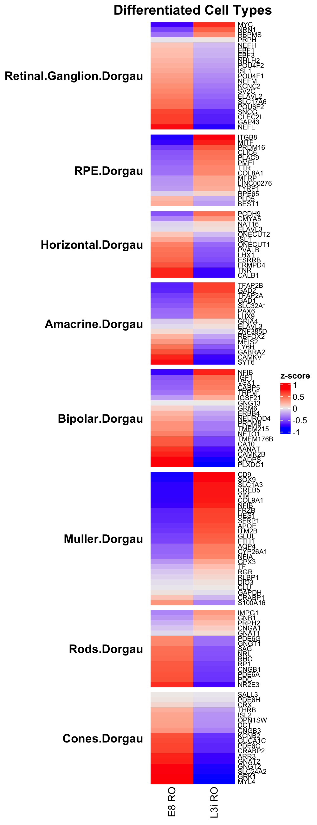
Undifferetiated cells
RO

Slide 8
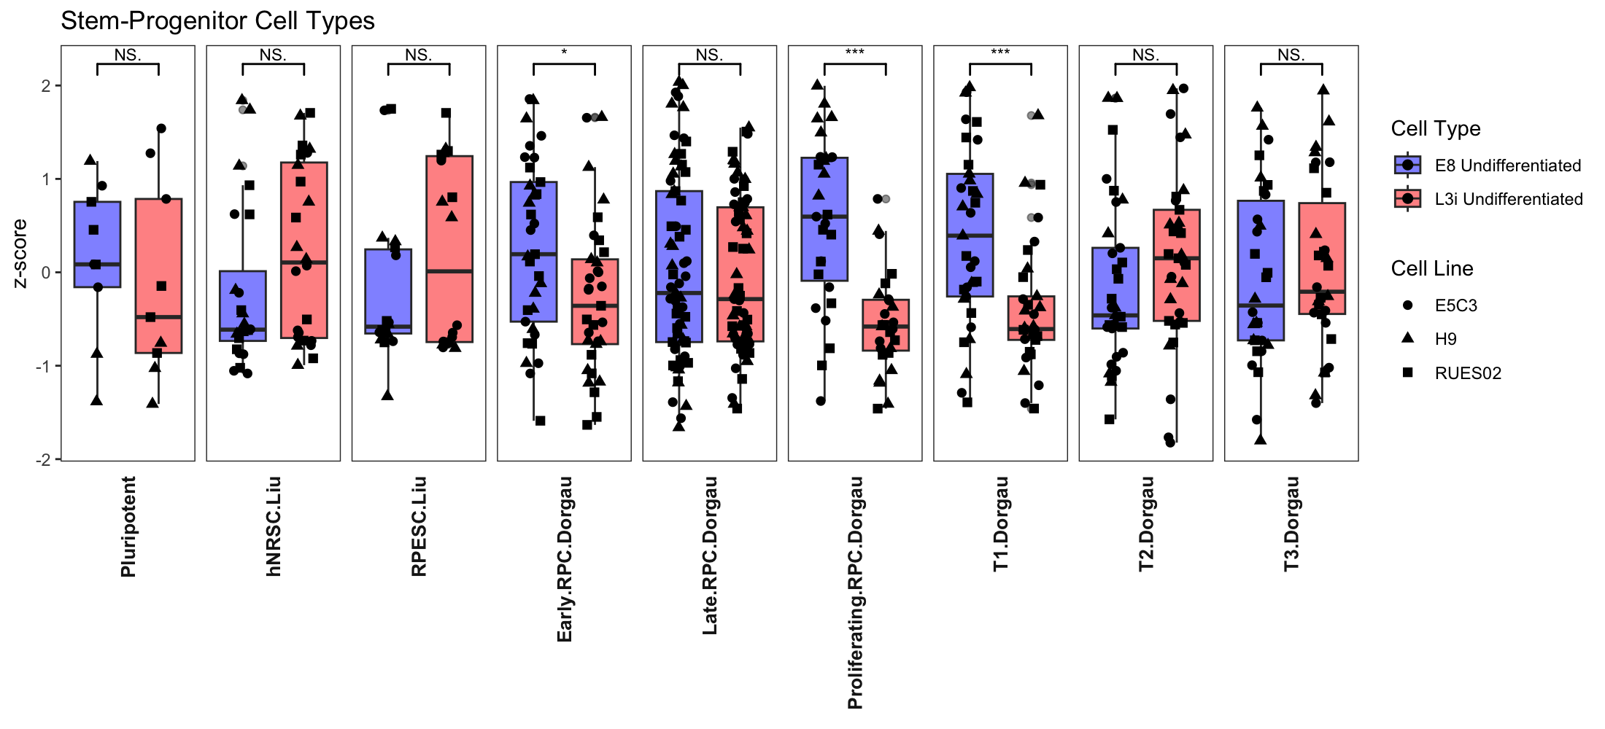
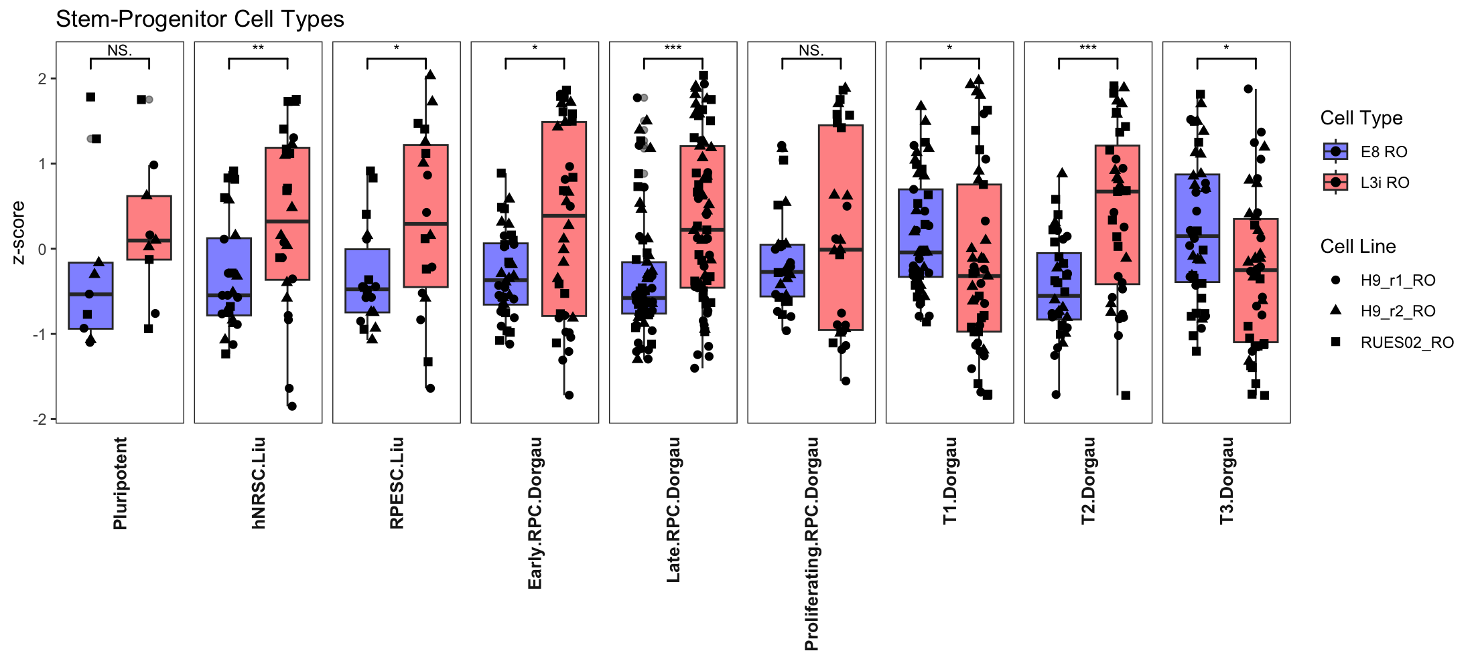
Undifferentiated Individual cell lines
z-scores
Stem-progenitor cell types genes

Slide 9
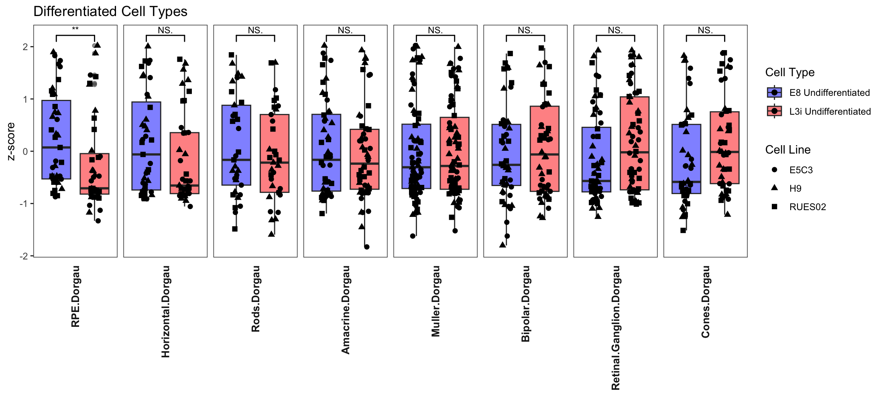
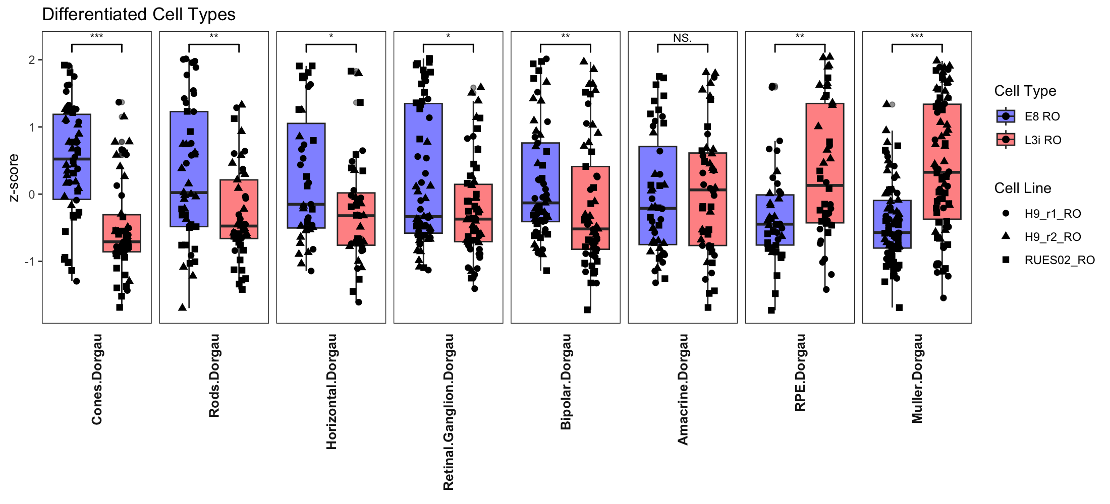
Undifferentiated Individual cell line
z-scores
Differentiated cell types genes

Slide 10
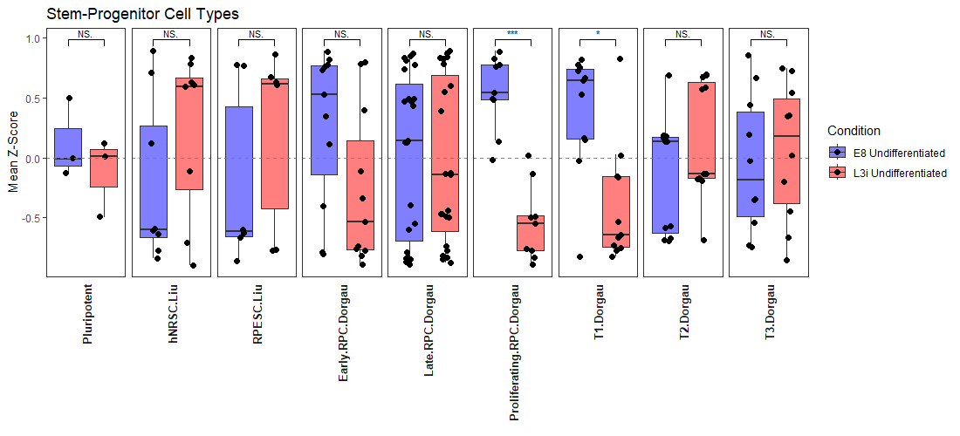
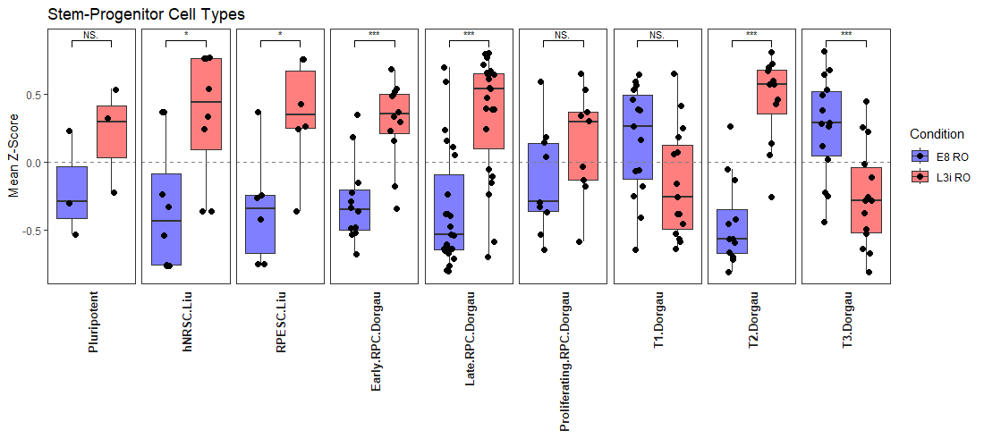
Undifferentiated Averaged
z-scores
Stem-progenitor celltypes genes

Slide 11
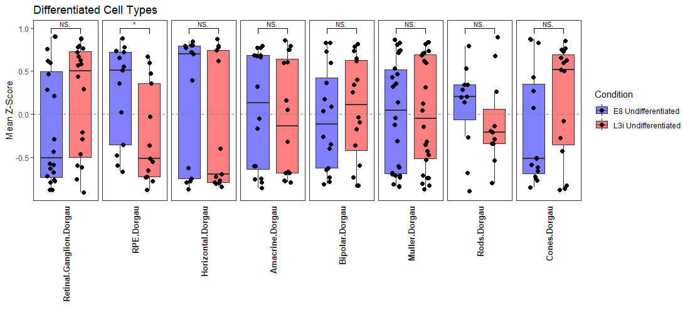
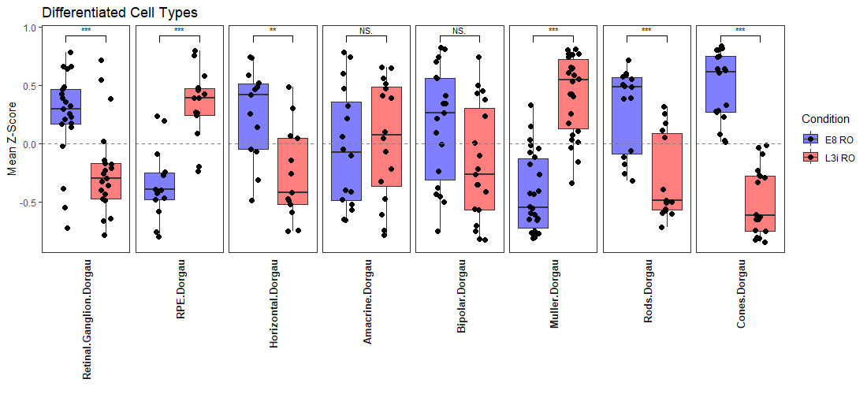
Undifferentiated Averaged
z-scores
differentiated celltype genes

